Slide 1
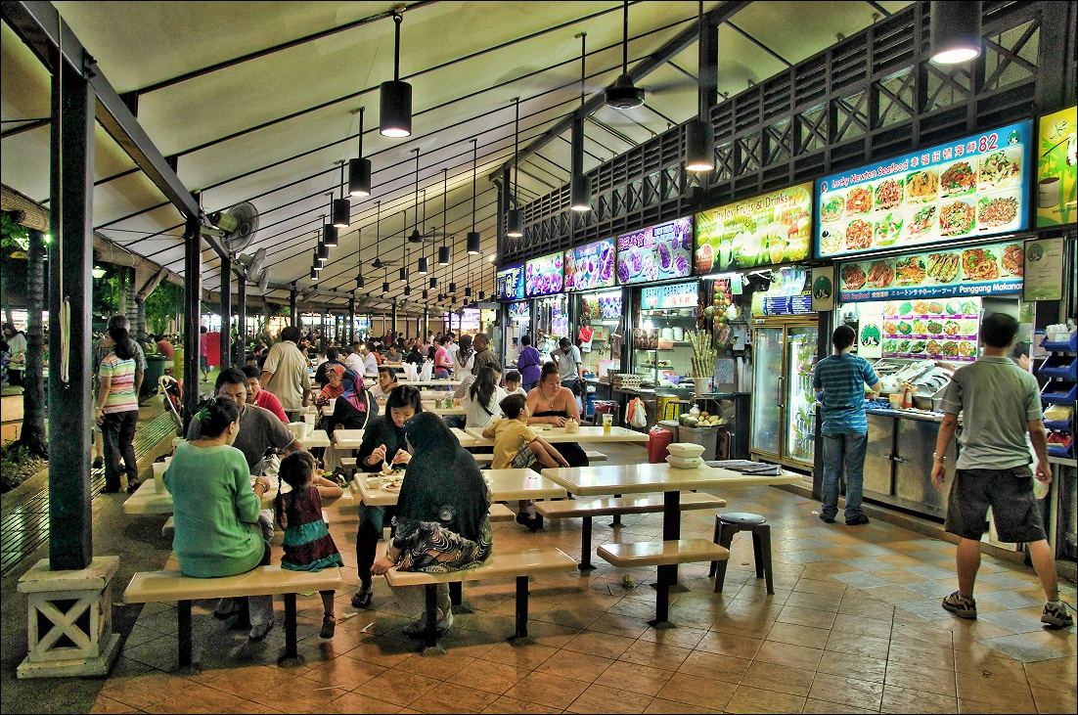
Hawker Centres in Singapore
BRENDA THNG
LIM WEN QING
NICHOLAS FOO
YONG ZHUN HUNG

Slide 2
The BACKGROUND
HAWKER DATASET
TRAIN STATION DATASET
POPULATION PER PLANNING AREA DATASET
INCOME PER PLANNING AREA DATASET

Slide 3
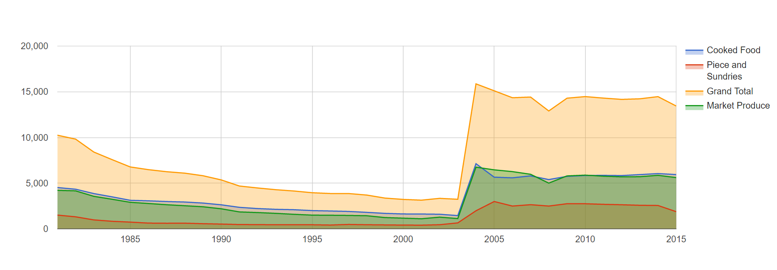
NUMBER OF LICENSES

Slide 4
On 1 April 2004, the management of markets and hawker centres was consolidated under the National Environment Agency (NEA).

Slide 5
Did you know...
THE HAWKER CULTURE IN SINGAPORE IS DYING OUT
SO LET US SHARE WITH YOU SOME INTERESTING FINDINGS ABOUT THEM WHILE THEY’RE STILL HERE

Slide 6
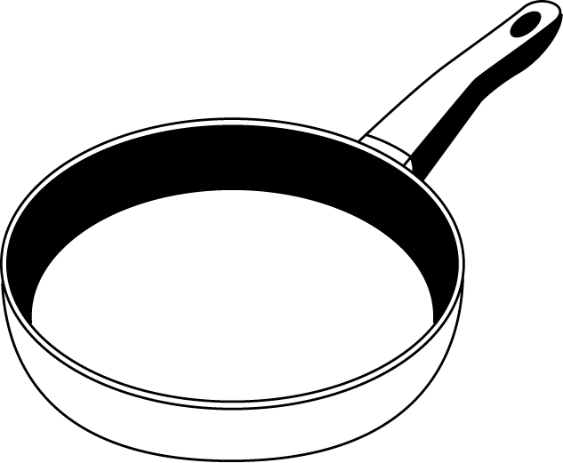

Fun Facts:
Fun Facts:
108 Hawker Centres 130 Stalls on Average
Geylang Serai Market 302
Tiong Bahru Market 259
Cooked Stalls
57
Chinatown Market 477
Tekka Market 284
73
Market Produce
Notes:
There are about 108 hawker centres, 130 stalls on average within hawker centeres.
Of the 130 on avg there are 73 market produce market produced stalls and 57 cooked stalls.
On the left you can see are the top 4 hawker centrees with the greatest market produce, basically selling fresh food
Using the MRT data we calculated the average distance an mrt is from the hawker cnetre.
More likely to have hawker centres within 500 m radius of mrt stations in accordance to government plans.
However, not all hawker centres and mrt stations are evenly spread.
In the next slide u can see that alot of hawker centres and mrts are populated towards the south.
Up north and towards the rest there are alot of orange dots, these are LRTs and we can see that its a possible place that government is aiming to set up hawker centres
Then again theres a reason why certain areas are more populated with hawker centres which will be touched on by my groupmate.

Slide 7
Distance
Hawker Centre
8.8KM
Hawker Centre
Hawker Centre
549.7M
MRT Station
Notes:
Using the MRT data we calculated the average distance an mrt is from the hawker cnetre.
More likely to have hawker centres within 500 m radius of mrt stations in accordance to government plans.
However, not all hawker centres and mrt stations are evenly spread.
In the next slide u can see that alot of hawker centres and mrts are populated towards the south.
Up north and towards the rest there are alot of orange dots, these are LRTs and we can see that its a possible place that government is aiming to set up hawker centres
Then again theres a reason why certain areas are more populated with hawker centres which will be touched on by my groupmate.

Slide 8
MRT

Slide 9
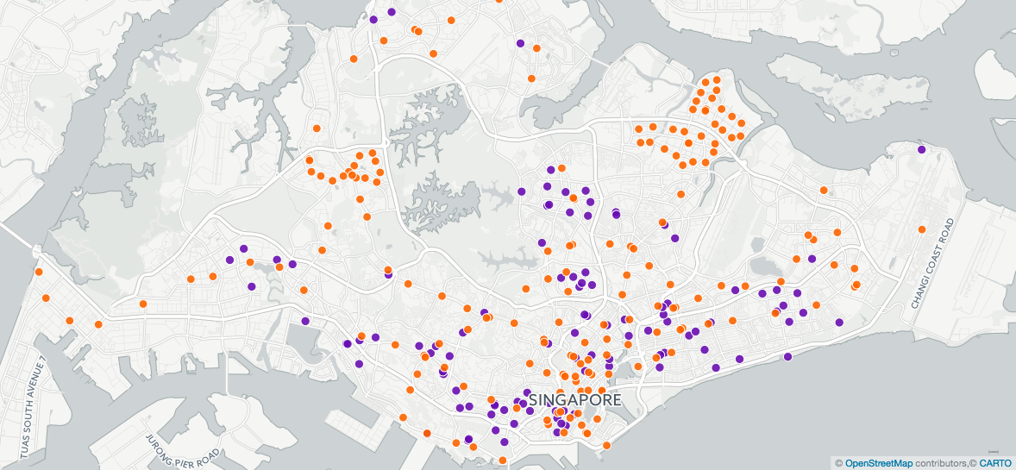
Hawker Centres:
Distribution of MRTs in relation to Hawker Centres
MRT/LRTs:
MRTs and Hawker Centres are accumulated towards the south
Notes:
It’s not distributed evenly

Slide 10
Compactness

Slide 11
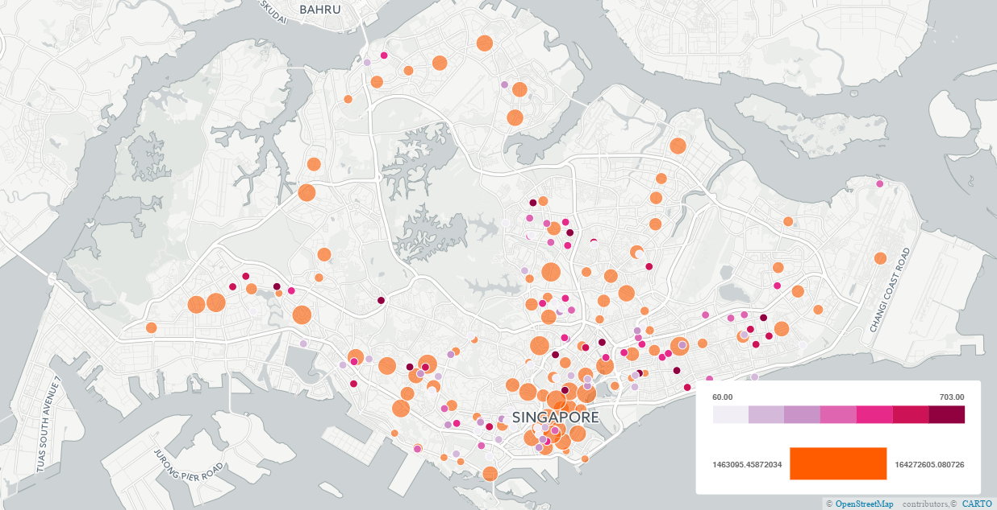
Hawker Centres:
Neighbourhood Compactness:
Higher compactness index → More hawker centers
CBD area, Bugis, Suntec, Raffles Place

Slide 12
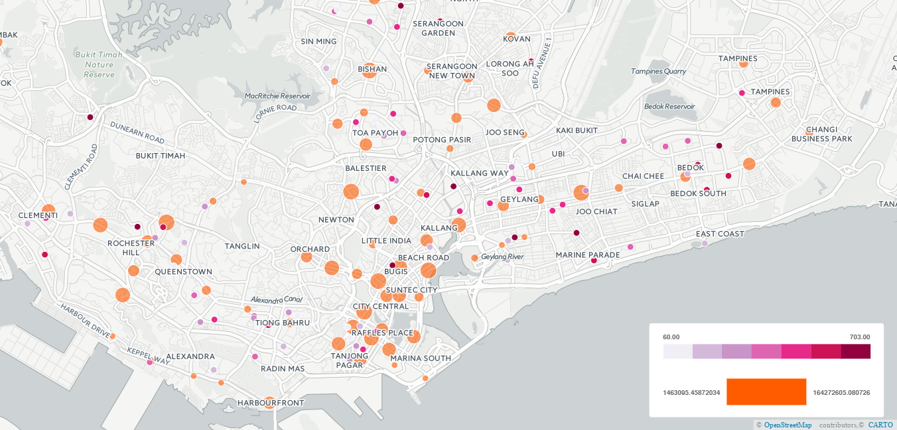
Hawker Centres:
Neighbourhood Compactness:
Higher compactness index → More hawker centers
No correlation between number of hawker centers and compactness
Notes:
Zoomed in version of slide 9

Slide 13
Total Population

Slide 14

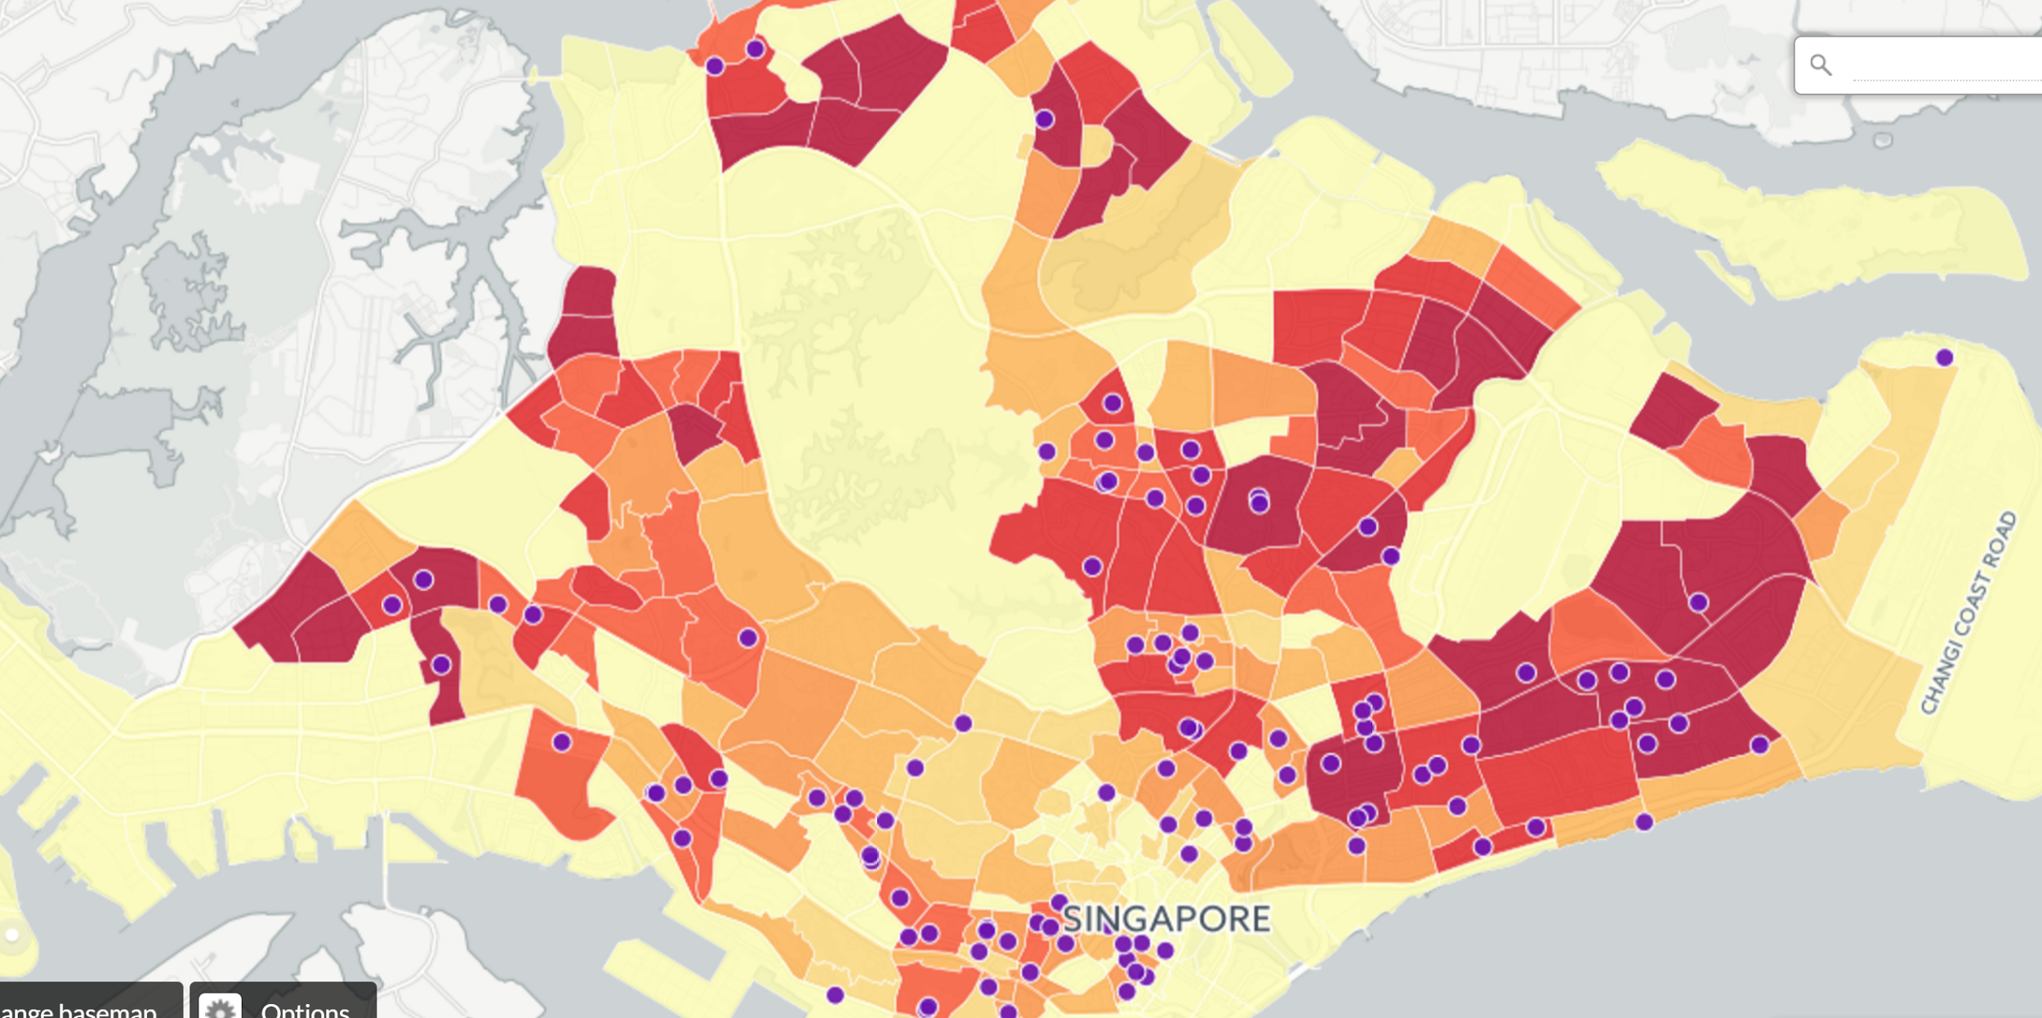
Hawker Centres:
Population Density:
Total Population
Notes:
Total Population

Slide 15
Age Group

Slide 16
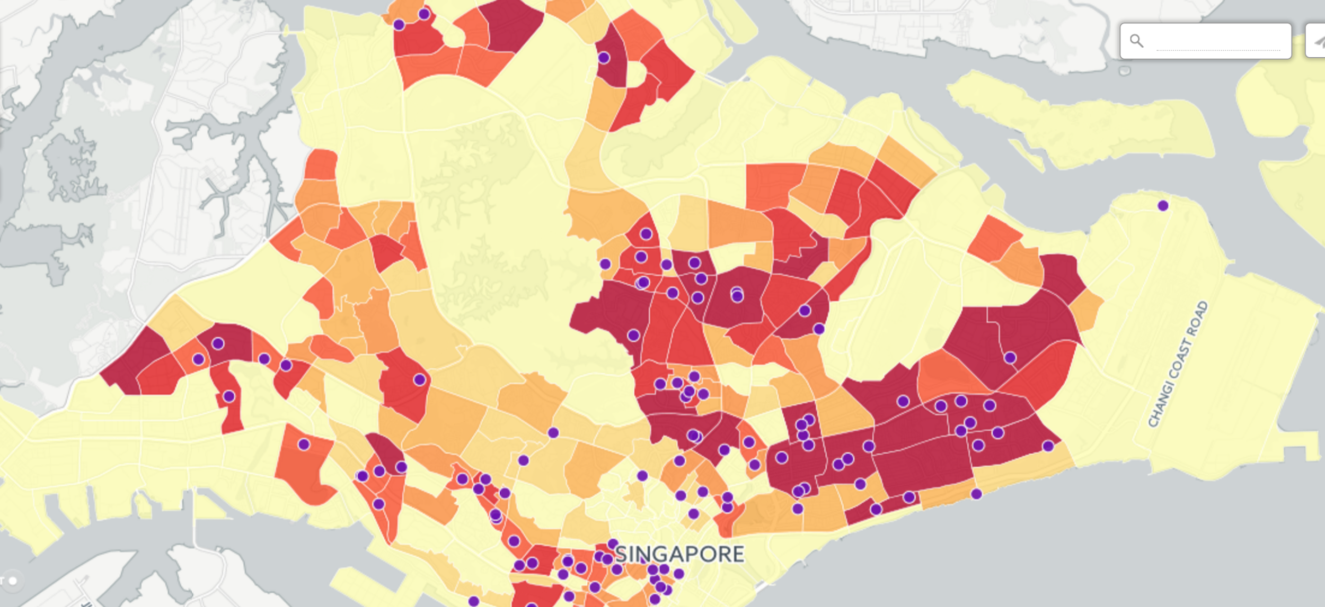
Hawker Centres:
Population Density:
Elderly
Notes:
Elderly

Slide 17
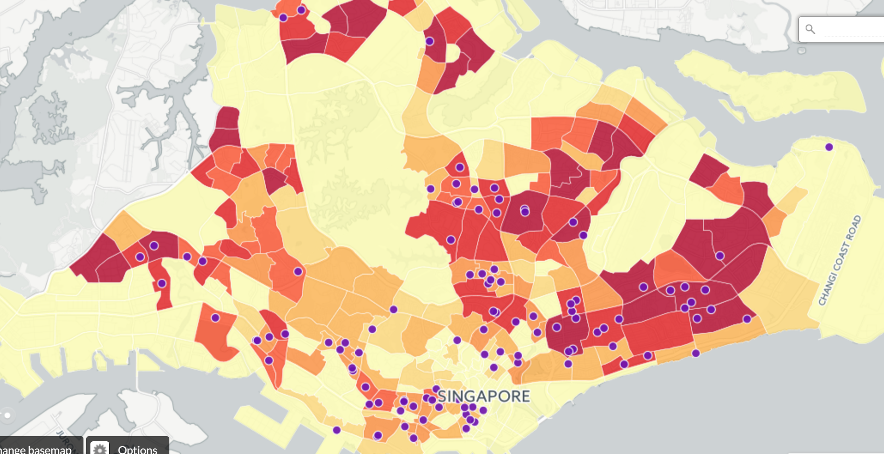
Hawker Centres:
Population Density:
Middle-Aged
Notes:
Middle Aged

Slide 18
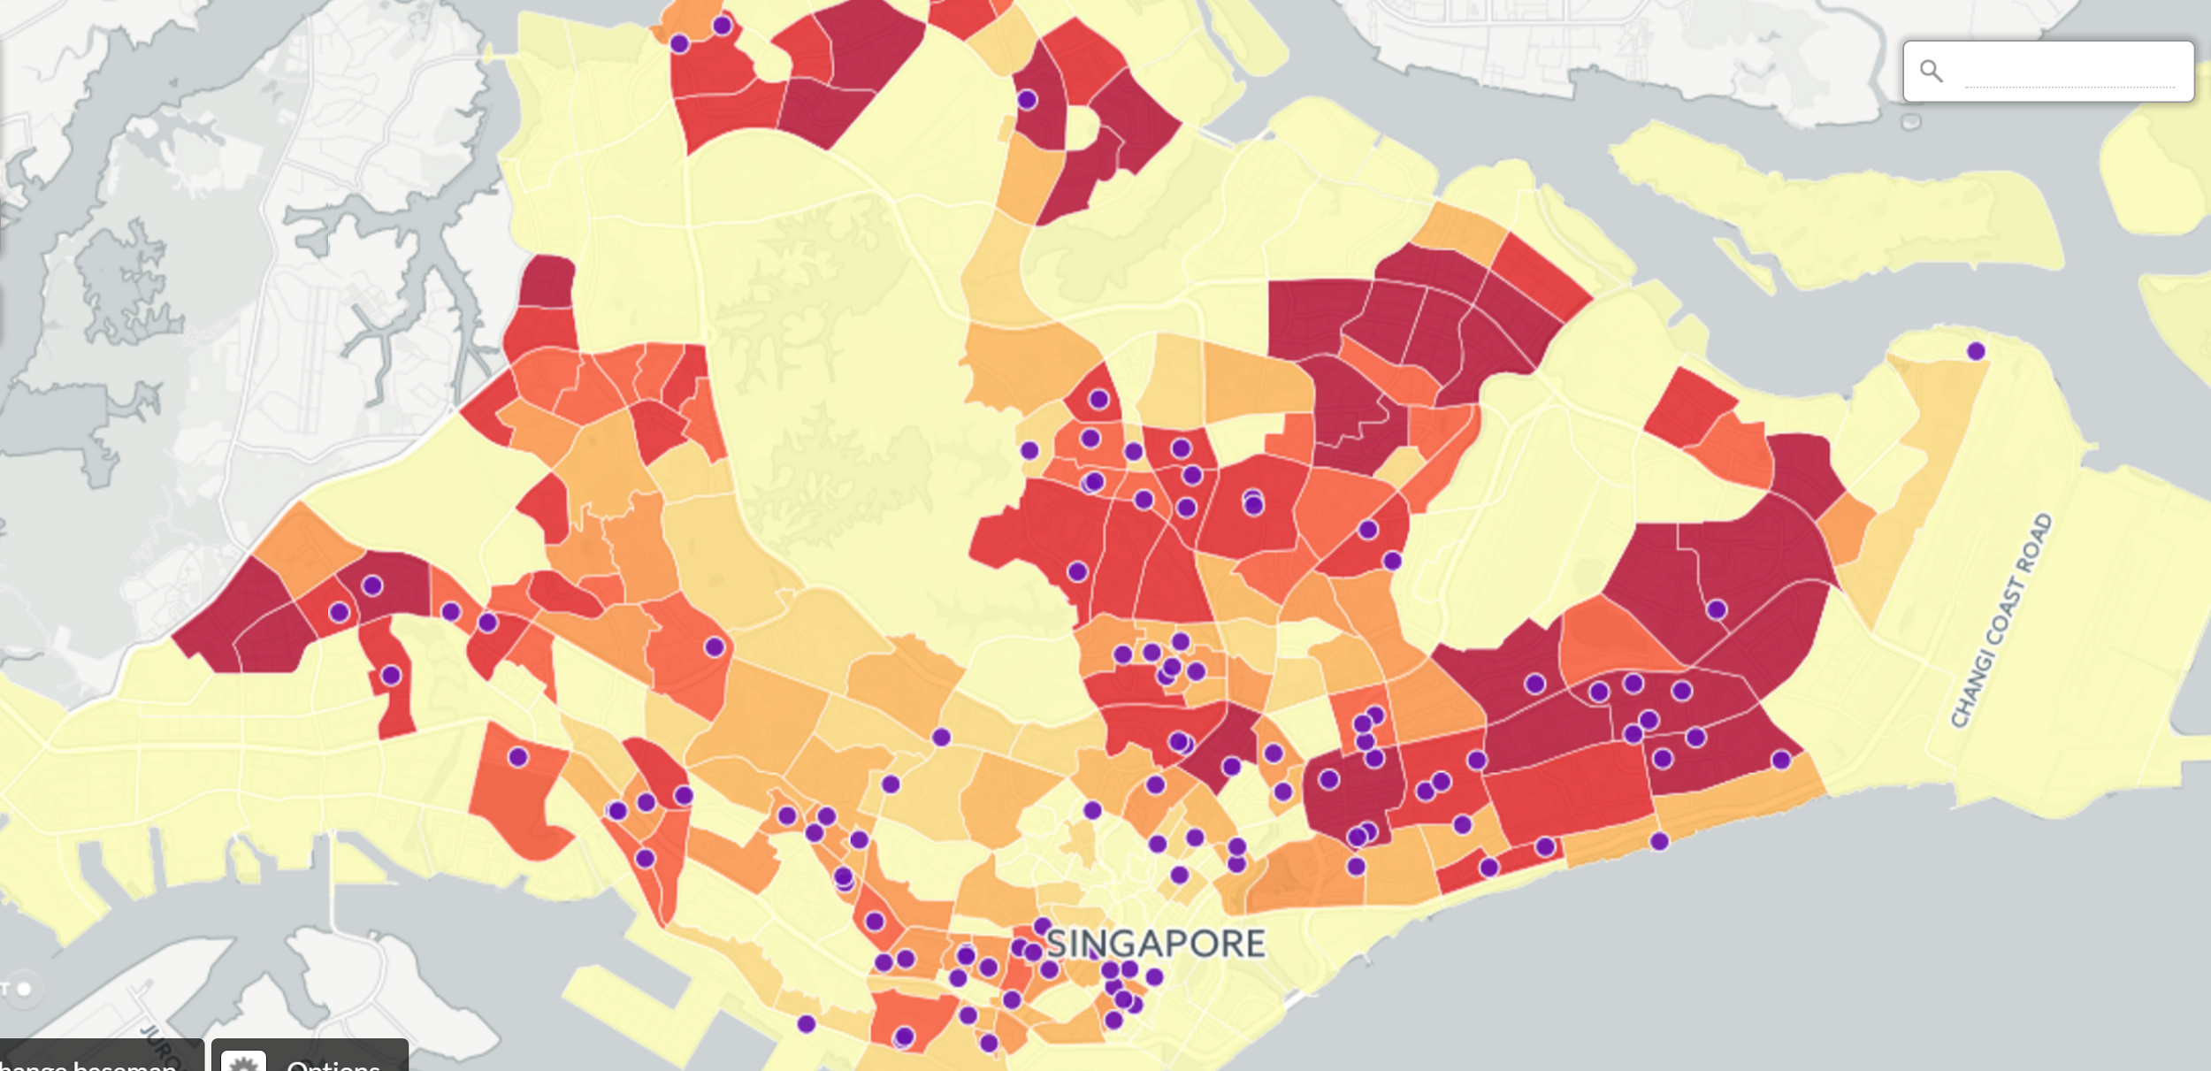
Hawker Centres:
Population Density:
Young Adults
Notes:
Young adults

Slide 19
Income

Slide 20
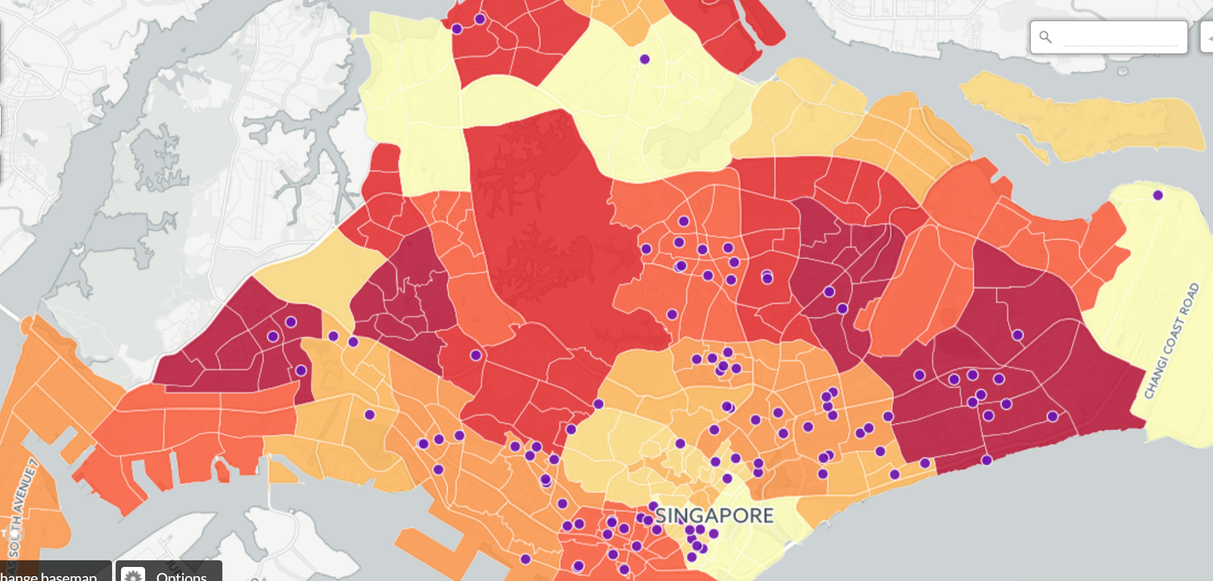
Hawker Centres:
Population Density:
High Income (>$9999)
Notes:
Income: High income

Slide 21
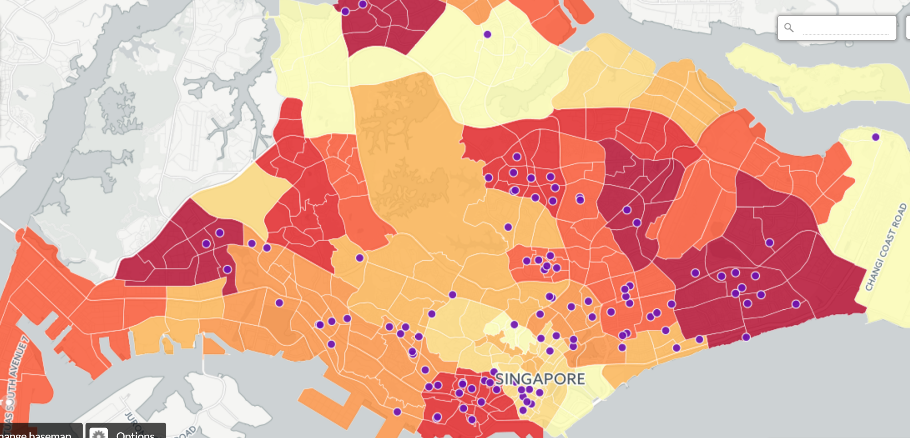
Hawker Centres:
Population Density:
Middle Income ($2000~$9999)
Notes:
Middle Income

Slide 22
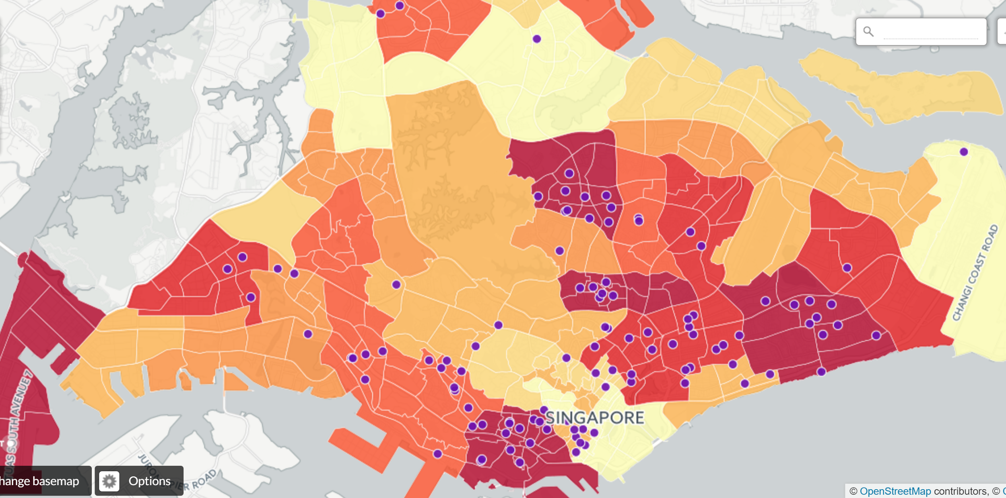
Hawker Centres:
Population Density:
Low Income (<$1999)
Notes:
Low income

Slide 23
THANK YOU!

